Slide 1
What teenagers like to wear

Slide 2
Intro
Nowadays, teenagers are inspired by celebrities as singers, models, actors/actresses, from their school environment, the kinds of music they listen to and other standards.
A lot of teenagers’ outfits are similar with their feelings or their problems. There are many types and styles of dress up such as:
Preppy style
Street style
Punk style
Hipster style
Through fashion teenagers make friends, relationships and communicate with each other .

Slide 3
Preppy style
Preppy style refers to a subculture in the United States associated with the old private Northeastern university-preparatory schools. The terms are used to denote a person seen as characteristic of a student or alumnus of these schools. Prep has become a colloquialism in the United States and has largely replaced preppy in modern usage. Characteristics of preps in the past, include a particular subcultural speech, vocabulary, dress, mannerisms, etiquette, reflective of an upper-class upbringing.
Examples of preppy attire include argyle sweaters, crewneck sweaters, grosgrain or woven leather belts, chinos, madras, Nantucket Reds, button down Oxford cloth shirts, pearl necklaces and earrings, gold bangle or large chain bracelets, penny loafers, polo shirts and boat shoes (Wikipedia).

Slide 4
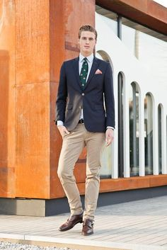
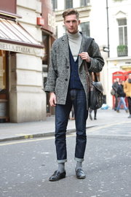
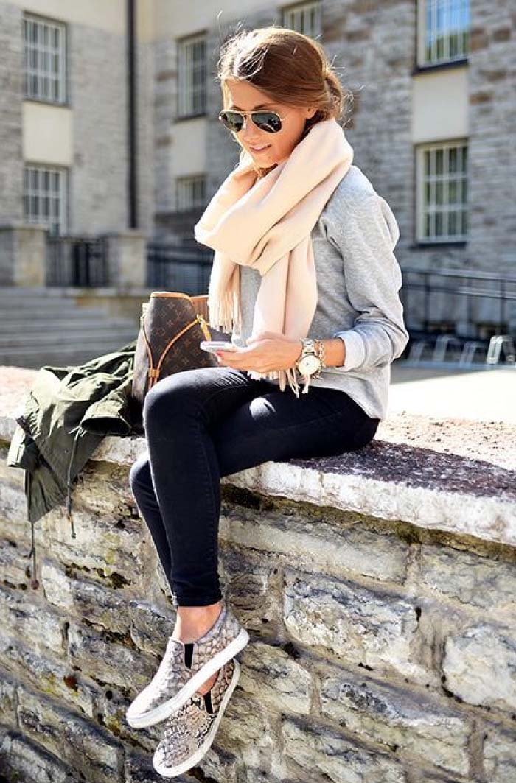

Slide 5
Street style
Street fashion is fashion that is considered to have emerged not from studios, but from the grassroots. Street fashion is generally associated with youth culture, and is most often seen in major urban centers. Magazines and Newspapers like the New York Times and Elle commonly feature candid photographs of individuals wearing urban, stylish clothing. Japanese street fashion sustains multiple simultaneous highly diverse fashion movements at any given time. Mainstream fashion often appropriates street fashion trends as influences (Wikipedia).

Slide 6
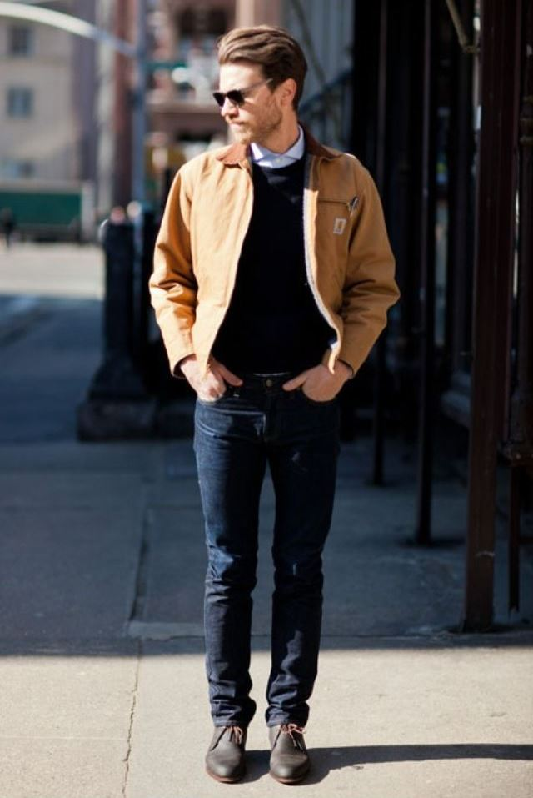

Slide 7
punk style
Punk fashion is the clothing, hairstyles, cosmetics, jewellery, and body modifications of the punk subculture. Punk fashion varies widely, ranging from Vivienne Westwood designs to styles modelled on bands like The Exploited to the dressed-down look of North American hardcore. The distinct social dress of other subcultures and art movements, including glam rock, skinheads, rude boys, greasers, and mods have influenced punk fashion. Punk fashion has likewise influenced the styles of these groups, as well as those of popular culture. Many punks use clothing as a way of making a statement (Wikipedia).

Slide 8
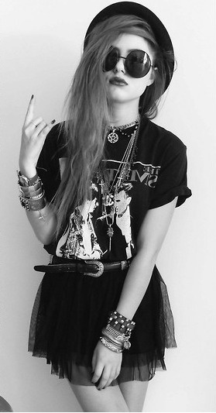
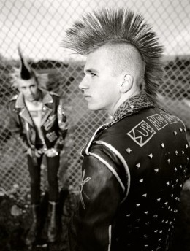

Slide 9
Hipster style
The hipster subculture is composed of affluent or middle class young Bohemians who reside primarily in gentrifying neighbourhoods. It is broadly associated with indie and alternative music, a varied non-mainstream fashion sensibility (including vintage and thrift store-bought clothes), generally progressive political views, organic and artisanal foods, and alternative lifestyles. The subculture typically consists of white millennials living in urban areas. It has been described as a "mutating, trans-Atlantic melting pot of styles, tastes and behaviour“ (Wikipedia).

Slide 10
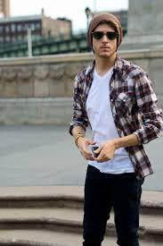

Slide 11
VASSILIKI FOTOPOULOU GIOTA STAVRIANOU:

