Slide 1
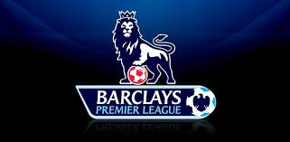
English Football

Slide 2
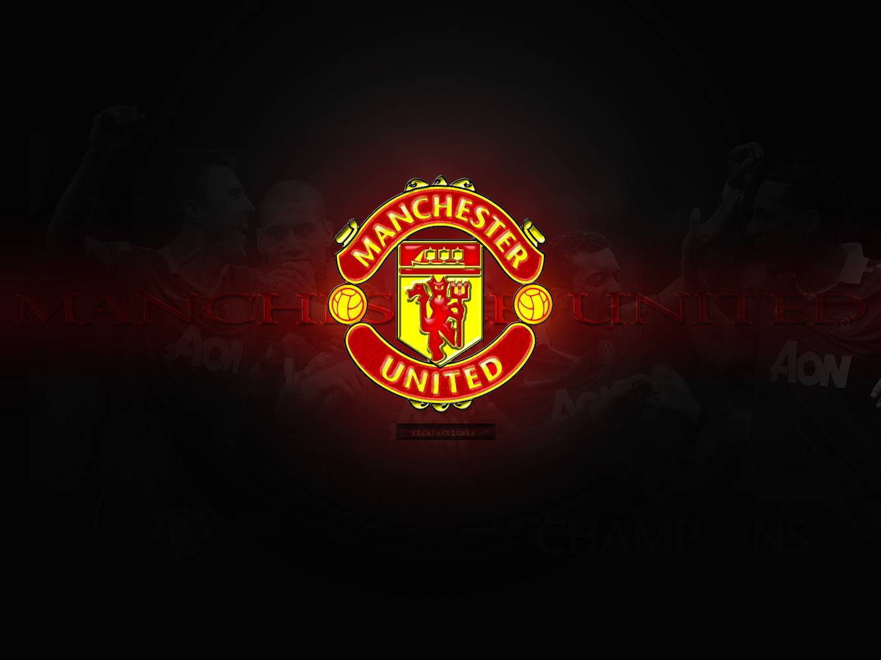
England's Best Teams
1. Manchester United
Manchester United is a professional football club based in Old Trafford and founded in 1878. Also Munchester United has won the Premier League 20 times, England's Cups 15 times and the Champions Leagues 3 times & the Super Cup 1 time.

Slide 3
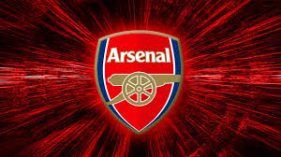
2. Arsenal
Arsenal is one of the most popular clubs in England based in Emirates Stadium and founded in 1886. Arsenal won the Premier League 13 times and England’s Cup 12 times.

Slide 4
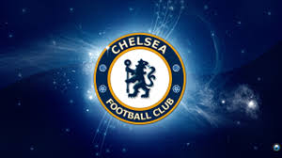
3. Chelsea
Chelsea was found in 1905 and its stadium is Stamford Bridge. It has won England’s League 5 times, the Champions League 1 time and the European League 1 time.

Slide 5
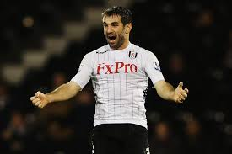
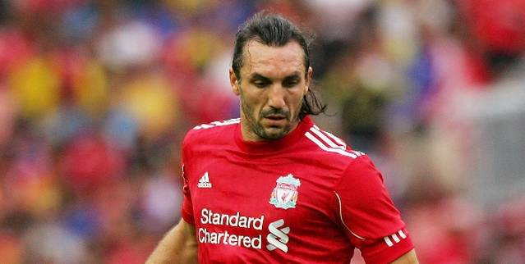
Greek Players in England
England also has had many players or ex-players from Greece.
Giorgos Karagounis (Fullham)
39 Appearances 1 Goal
Sotirios Kurgiakos (Liverpool)
30 Appearances 3 Goals

Slide 6
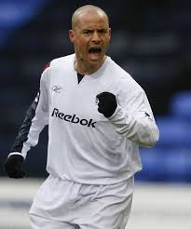
Stelios Gianakopoulos (Bolton Wanderers)
137 Appearance 20 Goals
Kostas Mitroglou (Fullham)
3 Appearances 0 Goals – Βecause he was injured -

Slide 7

England's National Team
England has also a great national team. It is based in Wembley Stadium. Now it is 13th in the world rankings but in 2012 it was 3rd which is its best ranking.

Slide 8

Achievements
It has played 14 times in the World Cup (Mundial) and in 1966 it won it. Also it has played 8 times in the European Championship and got the 3rd place in 1996.

Slide 9

The End
That was our project
By Panagiotis Tsoupis & Alkinoos Triandafullou

