Slide 1
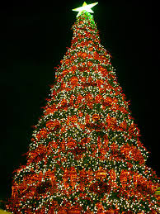
CΗRISTMAS

Slide 2
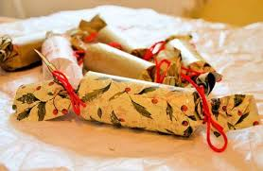
CHRISTMAS IN ENGLAND

Slide 3
In the UK (or Great Britain), families often celebrate Christmas together, so they can watch each other open their presents!
Most families have a Christmas Tree (or maybe even two!) in their house for Christmas. The decorating of the tree is usually a family occasion, with everyone helping. In Great Britain , the children write a letter to "Father Christmas", and they ask him for their gift. Then they throw the letter inside the fireplace so the smoke leaving the chimney takes it to Santa.

Slide 4
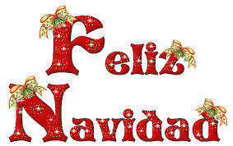
CHRISTMAS IN SPAIN

Slide 5
CUSTOMS
Most people in Spain go to Midnight Mass or 'La Misa Del Gallo' (The Mass of the Rooster). It is called like this because a rooster is supposed to have crowed the night that Jesus was born.
Most families eat their main Christmas meal on Christmas Eve before the service. The traditional Spanish Christmas dinner is 'Pavo Trufado de Navidad' which is turkey stuffed with truffles (the mushrooms, not the chocolate ones!) In Galicia (a region in north-west Spain, surrounded by water) the most popular meal for Christmas Eve and for Christmas Day is seafood. This can include all kinds of different seafood, from shellfish and mollusks, to lobster and small edible crabs.
In Spain, the Christmas season starts with the big draw of December 22. For the Spanish Christmas is the most important feast of the year and Christmas Eve (Noche Buena) is celebrated by the whole family together.

Slide 6
CHRISMAS IN ITALY

Slide 7
CUSTOMS
One of the most important ways of celebrating Christmas in Italy is the Nativity crib scene. Using a crib to help tell the Christmas story was made very popular by St. Francis of Assisi in 1223 (Assisi is in mid-Italy). The previous year he had visited Bethlehem and saw the stable, where it was thought that Jesus was born. A lot of Italian families have a Nativity crib in their homes.
In Italy, the Christmas season lasts from December 8 to January 6, which is the day of the Epiphany. On December 25 after the traditional lunch, the children recite poems and they are rewarded in cash. According to the Italian tradition, on Epiphany Eve the good witch Befana, flies over the houses with the magical broom and leaves Christmas gifts to the "good" children, while on the other hand, she leaves a sack of coal to the "naughty" ones.

Slide 8
FELIZ NAVIDAD ΙΣΠΑΝΙΚΑ
MARY CHRISTMAS ΑΓΓΛΙΚΑ
ΚΑΛΑ ΧΡΙΣΤΟΥΓΕΝΝΑ ΕΛΛΗΝΙΚΑ
FROHE WEIHNACHTEN ΓΕΡΜΑΝΙΚΑ
JOYEUX NOËL ΓΑΛΛΙΚΑ
BUON NATALE ΙΤΑΛΙΚΑ

Slide 9
MARRY CHRISMAS AND A HAPPY NEW YEAR
SIGALA ANNA

